Slide 1
Digital Portfolio
NAME : ABIZKHAN.A
NMID:83C75D1B7BA5713B5CC46319715558C0
DEPARTMENT : BCA
COLLEGE : VIDHYASAGAR COLLEGE OF ARTS AND SCIENCE
UNIVERSITY: BHARATHIYAR

Slide 2
PROJECT TITLE
My Portfolio

Slide 3


AGENDA
Problem Statement
Project Overview
End Users
Tools and Technologies
Portfolio design and Layout
Features and Functionality
Results and Screenshots
Conclusion
Github Link
3/21/2024 Annual Review

Slide 4

PROBLEM STATEMENT
In today's digital world, a traditionalresume is not enough to showcase skillsand achievements effectively. There is aneed for a personal portfolio websitethat highlights an individual's details,projects, and talents in a professionaland accessible way.

Slide 5

PROJECT OVERVIEW
*Thisprojectisaboutdevelopingapersonal portfoliowebsitetoshowcaseskills,education,projects,andachievementsinaprofessional and accessible manner.
*My Portfolio contains:About me, what I am learning, Contact.

Slide 6

WHO ARE THE END USERS?
The end users are recruiters, teachers, and others who want to view the creator's skills, projects, and achievements through the portfolio.

Slide 7

TOOLS AND TECHNIQUES
HTML,CSS, JAVASCRIPT: For designing and building the website.
CSS: For responsive design
code editor :
Vs Code

Slide 8
POTFOLIO DESIGN AND LAYOUT
#The portfolio is designed with a simple, responsive, and user-friendly layout.
#It includes sections for Home, About, Learning and Contact.
#The design uses a clean color scheme, readable fonts, and a structured layout for easy navigation.
8

Slide 9
FEATURES AND FUNCTIONALITY
*Sections: Home, About, Skills, Learning,Contact.
*Easy navigation with menu links.
*Contact link (email).
*Clean and professional interface.

Slide 10
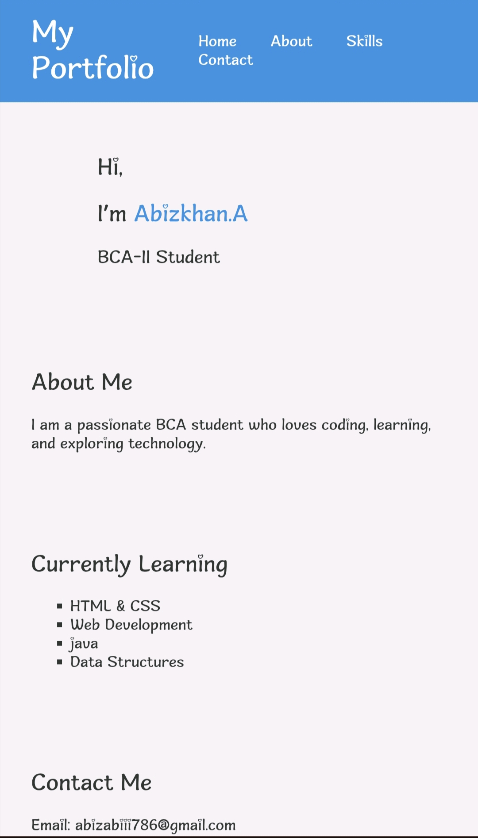

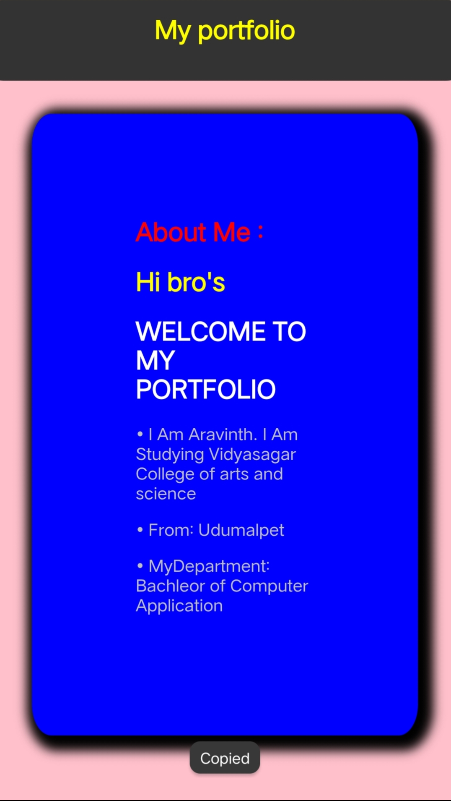
RESULTS AND SCREENSHOTS
3/21/2024 Annual Review
10

Slide 11
CONCLUSION
The portfolio website provides a professional and accessible platform to showcase personal details, skills, and achievements. It serves as a digital resume that enhances visibility and career opportunities.
11

